Slide 1


Database Management System
Arun Balasubramanyan
Jeya Gandhi Rajan M
Muthu Sundaravadivel
IBM Software Lab
Feb 2020

Slide 2
Agenda
Database Management System
Relational Database
No-SQL
DBaaS (Database-as-a-Service)
Different Databases
Redis
Data Structures
Advanced Data Structures
Use cases
Autocomplete
Pub Sub, Chat and Events
Geo Search

Slide 3
DBMS

Slide 4
Database Management System
Systematic process for managing data
A software that provides users with a systematic process of
creating,
collecting,
storing,
organizing,
retrieving,
updating and
managing data
in a database.
Centralized View of Data
A critical component of a database management system is the centralized view of data that varying users can access from multiple locations.
Additional attributes
Additional attributes include
logging and auditing of activity,
change management, performance monitoring,
backup and recovery. Concurrency,
Security,
data integrity
Notes:
A database management system is software that provides users with a systematic process of
creating,
collecting,
storing,
organizing,
retrieving,
updating and
managing data in a database.
A critical component of a database management system is the centralized view of data that varying users can access from multiple locations.
Additional attributes include
logging and auditing of activity,
change management,
performance monitoring, and
backup and recovery.
Concurrency, security and data integrity are also pivotal elements.

Slide 5
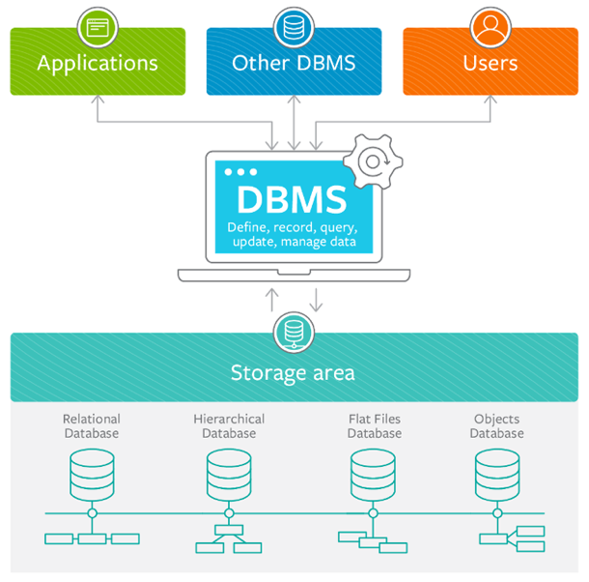
Database Management System

Slide 6
Database Management System
2 Types
Relational Database
No-SQL

Slide 7
Relational Database

Slide 8
Relational Database
Account
Relational Database
AccNo | AccName | Balance | Phone
100 | ABCD
101 | XYZ
A relational database organizes data into tables which can be linked or related based on data common to each.
Transaction
Trans Id | Date | AccNo | Amount
01 | 10-02-2020 | 100 | 3000
02 | 11-02-2020 | 101 | 5000
03 | 12-02-2020 | 100 | 1000
SQL
Structured Query Language (SQL)
The standard language for interacting with management systems.
SQL allows the joining of tables using a few lines of code.
SELECT * FROM ACCOUNT
Notes:
Relational Database
A relational database organizes data into tables which can be linked—or related—based on data common to each.
Account table
consists of the columns AccNo, AccName, Balance and Phone.
Transaction Table
Consists of the columns TransId, Date, AccNo and Amount
Both the tables are linked via AccNo table
SQL
The standard language for interacting with management systems. SQL allows the joining of tables using a few lines of code
Given the select statement to fetch all the data from ACCOUNT table

Slide 9

Relational Database
How application connects to Database
APPLICATION
DB ENGINE
(Server Process)
CONNECTOR
DATABASE FILES
CLIENT
DB SERVER
Every request from the Application via the connector will go through the network and reach DB Engine
DB Engine will read/write the data from/in the Database files available in the Disk.
All the Read/Write happens at the Disk.

Slide 10
Relational Database
Benefits
CREATE TABLE ACCOUNT (
AccNo NUMBER,
AccName VARCHAR2(50),
Balance NUMBER,
Phone NUMBER
);
Flexibility
Data Definition Language (DDL) the built-in language
DDL allows create/update/delete operations while db is running
Allows to change schema on the fly
Reduced redundancy
Account
AccNo | AccName | Balance | Phone
100 | ABCD
101 | XYZ
Avoid data duplication
Information is available only in one table. The reference table will have only the ID
Normalization
Transaction
Ease of backup and disaster recovery
Trans Id | Date | AccNo | Amount
01 | 10-02-2020 | 100 | 3000
02 | 11-02-2020 | 101 | 5000
03 | 12-02-2020 | 100 | 1000
Easy export and import options, making backup and restore trivial
Exports can happen even while the database is running
Modern, cloud-based relational databases can do continuous mirroring
Notes:
Here are the benefits of RDBMS
- Flexibility
-SQL has its a built-in language for creating tables called Data Definition Language (DDL).
-DDL allows you to add new columns, add new tables, rename relations, and make other changes even while the database is running and while queries are happening.
-This allows you to change the schema or how you model data on the fly
- Reduced redundancy
-Relational databases eliminate data redundancy.
-The information for a single customer appears in one place—a single entry in the customer table. The order table only needs to store a link to the customer table.
-The practice of separating the data to avoid redundancy is called normalization.
- Ease of backup and disaster recovery
-Most relational databases offer easy export and import options, making backup and restore trivial.
-These exports can happen even while the database is running, making restore on failure easy.
- Modern, cloud-based relational databases can do continuous mirroring, making the loss of data on restore measured in seconds or less.

Slide 11
Relational Database - Examples
Examples
These are the some of the examples for relational databases
Notes:
These are the some of the examples for the RDBMS

Slide 12
No-SQL

Slide 13
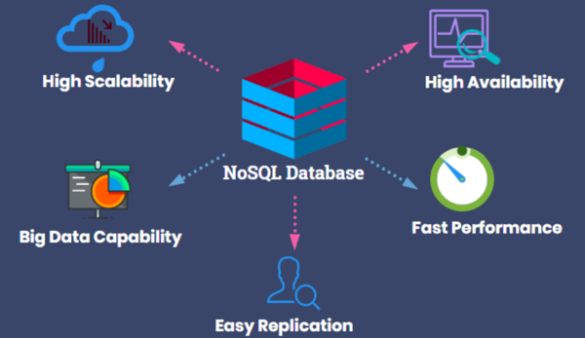
No SQL
No-SQL
Provides flexible schemas for the storage and retrieval of data
"No" means "not only"
NoSQL may support SQL like queries as well
NoSQL and RDBMS are used together in a single application.
The important attributes of NoSQL are
Scale
Performance
Ease of use
Notes:
Provides flexible schemas for the storage and retrieval of data
"No" means "not only"
"No" in "NoSQL" is an abbreviation for "not only" and not the actual word "No."
NoSQL may support SQL like queries as well
NoSQL and RDBMS are used together in a single application.
The important attributes of NoSQL are
Scale
Performance
Ease of use

Slide 14
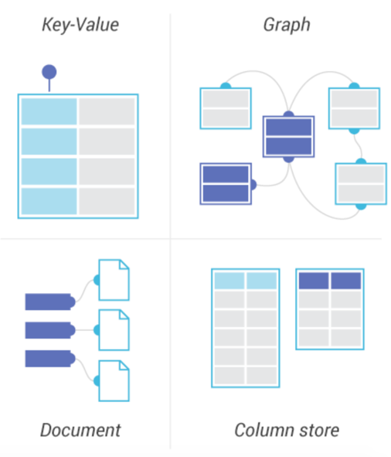
No-SQL : Primary Data Model
Key Value Store
Document-based
Column-based
Graph Based

Slide 15
No-SQL : Primary Data Model
Key Value Store
Every entity (record) is a set of key-value pairs
Key is usually a simple string
Value is usually some primitive data type (string, integer, array) or a more complex object
Key
Value
City
Chennai
Use cases:
To store user session data
To store user profiles
To store user preferences
To store shopping cart data
Country
India
Pincode
600102

Slide 16
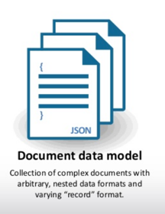
No-SQL : Primary Data Model
Document-based
key is usually a simple string
Value contains structured or semi-structured data. Value is referred to as a document and can be in XML, JSON or BSON format
Use cases:
Blogging platforms
Content management systems
Analytics platforms
Not suitable:
Not suitable for complex search queries
Not suitable for multiple operations transactions

Slide 17
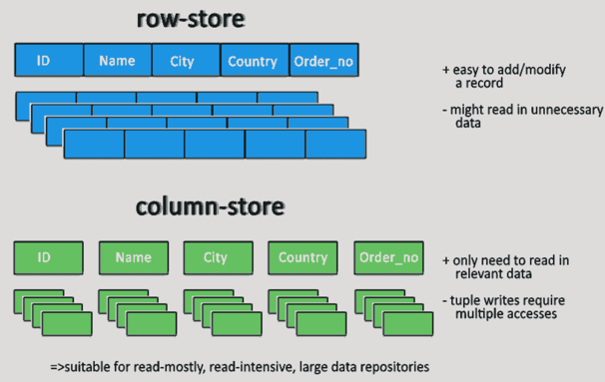
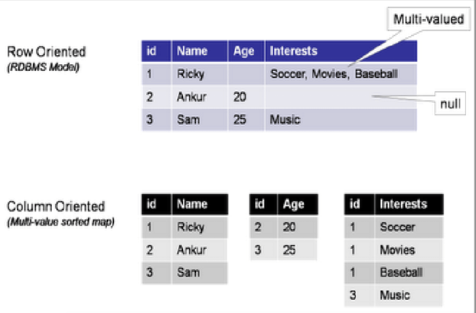
No-SQL : Primary Data Model
Column-based
Data is stored in cells grouped in columns of data rather than as rows of data
Read and write is done using columns rather than rows.
Can be used in systems that require heavy write requests (like log aggregators)

Slide 18
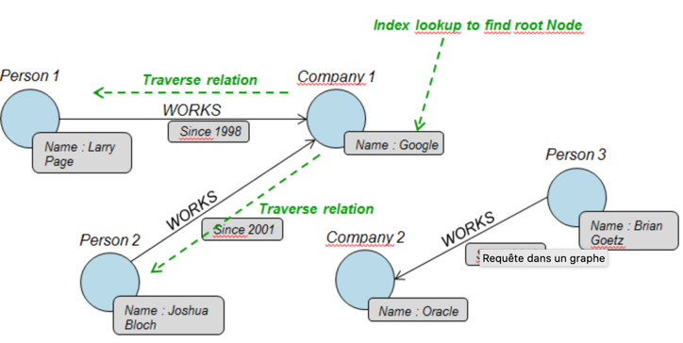
No-SQL : Primary Data Model
Graph-based
Graph databases are basically built upon the Entity – Attribute – Value model
Useful for visualizing, analyzing, or helping you find connections between different pieces of data
Businesses leverage graph technologies for recommendation engines, fraud analytics, and network analysis.
Person
Company
Id | Name
1 | Larry Page
2 | Joshua Bloch
3 | Brian Goetz
Id | Name
1 | Google
2 | Oracle
Works in
Person Id | Company Id | Since
1 | 1 | 1998
2 | 1 | 2001
3 | 2 | 2010

Slide 19
No-SQL Examples
Many NoSQL databases were designed by young technology companies like Google, Amazon, Yahoo, and Facebook to provide more effective ways to store content or process data for huge websites.
Apache CouchDB
JSON document-based database that uses JavaScript as its query language
Apache Cassandra
Wide-column store database designed to manage large amounts of data across multiple servers and clustering that spans multiple data centers
MongoDB
Document-based database that uses JSON-like documents and schema,
It is the database component of the MEAN stack
Redis
In-memory key value store used for session caching, message queues, and other specific applications
Elasticsearch
A document-based database that includes a full-text search engine

Slide 20
DBaaS (Database-as-a-Service)

Slide 21

DBaaS (Database-as-a-Service)
DBaaS (also known as managed database service)
It is a cloud computing service
It lets user access and use a cloud database system without purchasing and setting up their own hardware
The cloud provider takes care of everything
Periodic upgrades
Backups
Security
The market for DBaaS and cloud databases is among the fastest-growing Software-as-a-Service (SaaS) markets
DBaaS

Slide 22
Different Databases

Slide 23
Different Databases
1. ORACLE
2. DB2
Oacle database is the most widely used object-relational database management software
Ideal for: Large organizations that handle enormous databases and need a variety of features.
The cost of Oracle can be prohibitive, especially for smaller organizations.
IBM Db2® Database is a RDBMS that provides users with the ability to perform transactional, analytical and warehousing functions with the data contained in the database.
The recent launch of Db2 11.5 has broadened the scope of Db2’s data management practice to include AI.
Ideal for: Large organizations that need to make the most of available resources and handle large databases.
3. MYSQL
4. Microsoft SQL Server
MySQL is one of the most popular databases for web-based applications. It’s freeware
Support is available for the free version, but you’ll need to pay for it.
Ideal for: Organizations that need a robust database management tool but are on a budget.
SQL Server is an RDBMS and It works very well with other Microsoft products
Ideal for: Large organizations that use a number of Microsoft products.
Enterprise pricing may be beyond what many organizations can afford.

Slide 24
Different Databases
5. PostgreSQL
6. MongoDB
PostgreSQL is one of several free popular databases, and it is frequently used for web databases.
It supports JSON. It allows users to manage both structured and unstructured data.
Ideal for: Organizations with a limited budget that want the ability to select their interface and use JSON.
MongoDB is designed for applications that use both structured and unstructured data.
Free and commercial versions available.
It can process a large amount of data simultaneously and uses internal memory so the data is easily accessible.
7. MariaDB
8. SQLite
MariaDB is a highly available and scalable database management system.
It is available as free and also offers paid versions.
Ideal for: Organizations looking for an affordable MySQL alternative.
SQLite is used as a database system for mobiles.
It does not need much space hence, it can be used for storing small to medium size websites.
It is fast and does not need to set up.

Slide 25
REDIS

Slide 26
Redis (REmote DIctionary Server)
Redis is an in-memory database

Slide 27
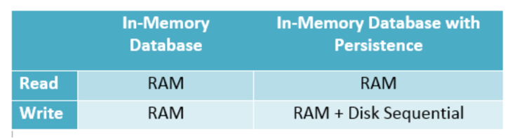
In-Memory Databases
Without Persistence
With Persistence
Queries
Queries
In-Memory Database
Main Memory
In-Memory Database
Main Memory
Updates
Updates
Log
Transaction Log
Notes:
RAM
volatile memory
Faster Execution , Performance Improvements

Slide 28
Redis (REmote DIctionary Server)
Redis is an in-memory, key-value datastore
Open Source
Distributed
It is often referred to as a data structure server
since it can contain strings, hashes, lists, sets and sorted sets
Many languages have Redis bindings
C, C++, C#, Go, Java, JavaScript (Node.js), Lua, Perl, PHP, Python, R, Ruby, Scala)
Very fast
About 110K SETs per second
About 81K GETs per second
Release in April 10, 2009
Written in ANSI C
Runs on Cross Platform
BSD License

Slide 29
Redis can be used as
Real-time analytics & chat apps
Metrics DB
Leaderboards (game high scores)
Geolocation lookup
API throttling (rate-limits)
Autocomplete
Social activity feed
Cache
Duplicate detector
UID Generator
Pub/Sub
Counting Stuff
LIFO/FIFO Queues
Priority Queue
Distributed HashMap

Slide 30
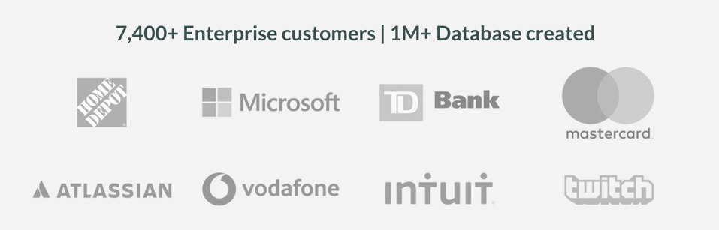




Who is using Redis
Who is using Redis
Notes:
Redis has been adopted by many enterprises.
There are around 7400+ enterprise customers adopted this.
1 Million plus databases are created

Slide 31
Redis Data Structures

Slide 32
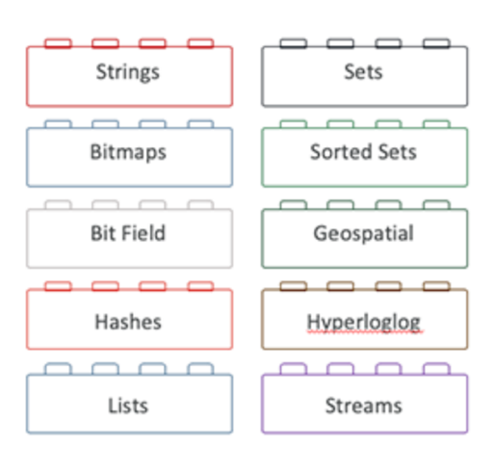
Redis Data Structures
Redis supported Data structures
Car1
Car2
Fruit1
Fruit2
City
INNOVA
SWIFT
Apple
Orange
Delhi
Cars-List
Fruits-List
INNOVA
SWIFT
SELTOS
KWID
INDICA
Apple
Orange
Mango
Cars-Set
Fruits-Set
INDICA
Orange
KWID
Mango
Apple
INNOVA
SWIFT
SELTOS
Notes:
Redis is not a plain key-value store.
Actually it is a data structures server, supporting different kind of values.
Here is the list of data structures supported by Redis
List
Set
Sorted sets
Hashes
Bit arrays
HyperLogLogs
They will be discussed in details in the further slides

Slide 33
REDIS Data Structures
String

Slide 34
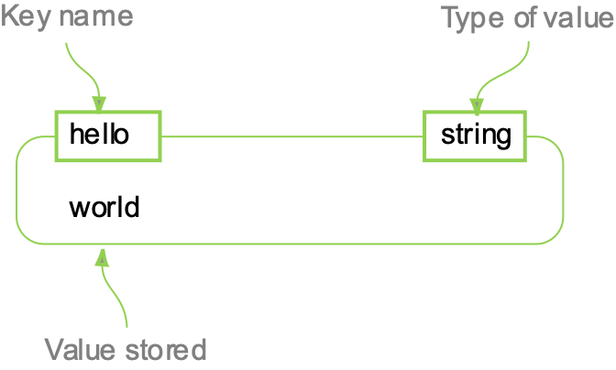
Strings
Key
STRINGs are similar to strings that we see in other languages.
Car1
Car2
Fruit1
Fruit2
City
INNOVA
SWIFT
Apple
Orange
Delhi
Value
Name = “James”
City = “Chennai”
Country = “India”

Slide 35
String
Add, Get and Delete elements
SET name “James”
name : “James”
GET name
James
SET
Sets the value at the specified key
GET
Gets the value at the specified key
DEL
Delete the key

Slide 36
REDIS Data Structures
List

Slide 37
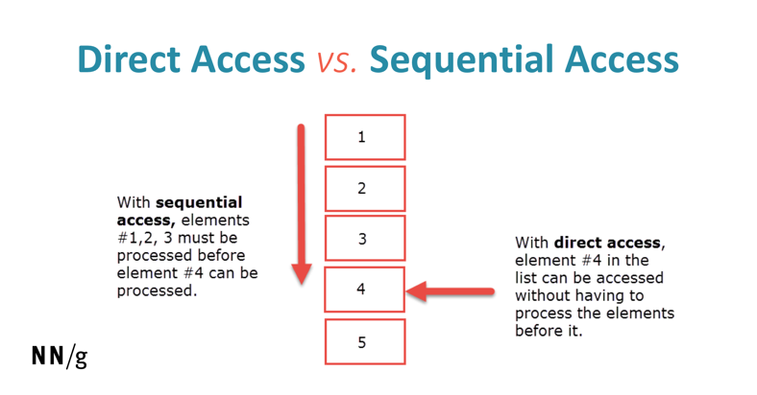
List
Lists or groups of strings
Sorted by insertion order
Elements can be pushed on the head or tail of the list
Often used as producer/consumer queries
Key
Cars
Fruits
INNOVA
SWIFT
SELTOS
KWID
INDICA
Apple
Orange
Mango
Value
Notes:
Its a group strings/collection of items.
Its sorted by the order of insertion( Whatever elements you put in last it will show in first).
List is an ordered collection it maintains the insertion order, which means upon displaying the list content it will display the elements in the same order in which they got inserted into the list.
List allows duplicates.
List allows any number of null values.
List implementations: ArrayList, LinkedList etc.
List support sequential access because the way that these data structures are stored in memory.
Insert/push the item head and tail of the list.
Lists are good when you are likely to touch only the extremes of the list: near tail, or near head. Lists are not very good to paginate stuff, because random access is slow,

Slide 38
List
Inserting Elements
LPUSH mylist a
“a”
LPUSH mylist b
“b”, “a”
RPUSH mylist “c”
“b”, “a”, “c”
LPUSH
Inserts a new element on the head (left)
RPUSH
Inserts a new element on the tail (right)
A new list is created when LPUSH or RPUSH is ran against an empty key
The key is removed from the keyspace if a list operation will empty the list

Slide 39
List
Inserting elements
mylist : []
LPUSH mylist a
mylist : [“a”]
LPUSH mylist b
mylist : [“b”, “a”]
RPUSH mylist “c”
mylist : [“b”, “a”, “c”]
LPUSH
Inserts a new element on the head (left)
RPUSH
Inserts a new element on the tail (right)
A new list is created when LPUSH or RPUSH is ran against an empty key
The key is removed from the keyspace if a list operation will empty the list

Slide 40
List
Retrieving elements
Friends: [“a”, ”b”, ”c”]
LRANGE friends 0 -1
a
b
c
LRANGE friends 1 2
b
c
LRANGE
Returns specified elements of the list
Offsets are zero-based indexes
Offsets can be negative indicating offsets starting from the end of the list

Slide 41
List
Length of the list
Friends: [“Eric”, ”Shawn”, ”Jose”]
LLEN friends
3
LLEN
Returns the length of the list
If list is empty, 0 is returned

Slide 42
List
Retrieve and Remove elements
Friends: [“Eric”, ”Shawn”, ”Jose”]
LPOP friends
Eric
Friends: [”Shawn”, ”Jose”]
RPOP friends
Jose
Friends: [”Shawn”]
LPOP
Removes and returns the first element of a list
RPOP
Removes and returns the last element of a list

Slide 43
REDIS Data Structures
Set

Slide 44
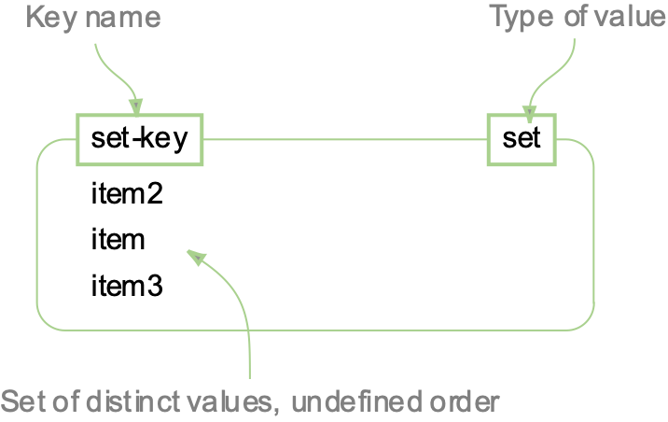
Set
Unordered collection of strings
Can add, remove and test for existence
Do NOT allow repeating members
Support server side commands to compute sets starting from existing sets
Key
Cars
Fruits
INDICA
Orange
Apple
KWID
Mango
Apple
INNOVA
SWIFT
SELTOS
Value
Notes:
Set its collection of object without any particular orderer.
Set doesn’t allow duplicate elements. All the elements of a Set should be unique if you try to insert the duplicate element in Set it would replace the existing value.
It will accept the empty or null value
Set implementations: HashSet, LinkedHashSet, TreeSet etc.
we can’t push and pop items from the ends like we did with LISTs. Instead, we add and remove items by value with the SADD and SREM commands.
Another cool thing about sets is support for peeking or popping random elements (SRANDMEMBER and SPOP commands).
Sets are also good to represent relations, e.g., "What are friends of user X?" and so forth. But other good data structures for this kind of stuff are sorted sets as we'll see.
Set support some basic operation like
Union
Intersection.
Difference.
Subset.

Slide 45
Set
Add & Remove elements
carmakers : [“TATA”, ”Maruti”]
SADD carmakers “Toyota”
carmakers : [“TATA”, ”Maruti”, ”Toyota”]
SREM carmakers “Maruti”
carmakers : [“TATA”, ” Toyota”]
SADD
Adds given values to a set
Values that already exist will be ignored
SREM
Removes values from a set

Slide 46
Set
Retrieving elements
carmakers : [“TATA”, ”Maruti”, ” Toyota”]
SMEMBERS carmakers
[“TATA”, ”Maruti”, ” Toyota”]
SRANDMEMBER carmakers
“Maruti”
SRANDMEMBER carmakers 2
[“TATA”, ” Toyota”]
SMEMBERS
Returns a list of all of the members of a set
SRANDMEMBER
Returns a random member of a set
SRANDMEMBER <<name>> <<count>>
Optional parameter to return a specified count of members

Slide 47
Set
Length of the Set
Friends: [“a”, ”b”, ”c”]
SCARD friends
3
SCARD
Returns the count of members / elements in a set
Returns 0 if key does not exist

Slide 48
Set
Retrieve and Remove elements
Friends: [“a”, ”b”, ”c”]
SPOP friends
b
Friends: [”a”, ”c”]
SPOP friends 2
[”a”, ”c”]
Friends: []
SPOP
Removes and returns a random member from a set
SPOP <<name>> <<count>>
Optional parameter to remove and return a specified count of members

Slide 49
Set
Check Member exists
friends: [“a”, ”b”, ”c”]
SISMEMBER friends “b”
1
SISMEMBER friends “d”
0
SISMEMBER
Tests if the given value is in the set
Returns 1 if the value is there and 0 if it is not

Slide 50
Set
Move Members to another list
friends: [“a”, ”b”, ”c”]
students: []
SMOVE friends students “b”
Friends: [“a”, ”c”]
Students: [”b”]
SMOVE
Moves member from one set to another

Slide 51
Set
Merge Members of 2 lists
friends: [“a”, ”b”, ”c”]
students: [”a1”, “b1”]
SMOVE friends students
[“a”, ”b”, ”c”, “a1”, “b1”]
SUNION
Combines two or more sets and returns a list of members

Slide 52
Set
Difference between lists
friends1: [“a1”, ”b1”]
friends2: [”a2”, “b2”, ”a1”]
friends3: [”a3”, “b3” , “b1”]]
SDIFF friends1 friends2
[ ”b1”, ”a2”, “b2”]
SDIFF friends1 friends2 friends3
[ ”a2”, “b2” ,”a3”, “b3”]
SDIFF
Returns the members of the set resulting from the difference between the first and all successive sets

Slide 53
REDIS Data Structures
Sorted Set

Slide 54
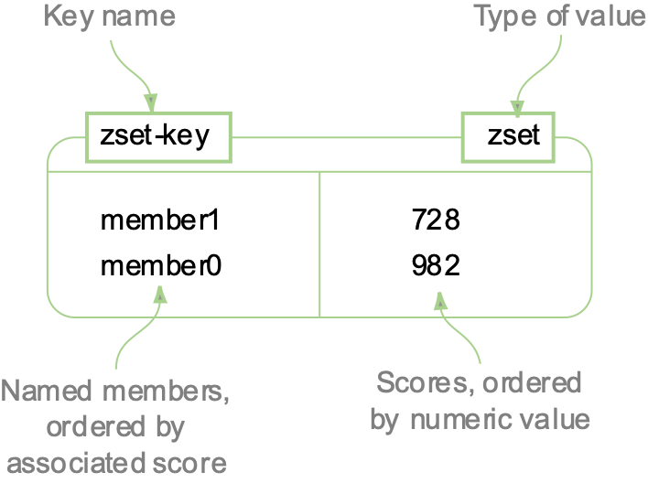
Sorted Set
Key
Since sets are unsorted, they can pose problems for some projects
Sorted Sets were created to solve that issue
Every member is associated with a “score”
Can access data very quickly
Like sets, elements may only appear once
Cars
Fruits
INNOVA (200)
Orange (100)
KWID (50)
Mango (500)
SWIFT (10)
SELTOS (100)
Apple (250)
INDICA (400)
Score is required
Must be a float / number
Score of 500 = 500.0
Score is NOT unique
Value
Notes:
sorted set is a set with ordering on its elements.
Sorted sets are sorted by their score in an ascending order.
The scores in a sorted set are double 64-bit floating point numbers
you can have all kinds of Top Something lists in your web application. Top users by score, top posts by pageviews.
Sorted sets are good for priority queues.
Sorted sets are like more powerful lists where inserting, removing, or getting ranges from the the middle of the list is always fast. But they use more memory, and are O(log(N)) data structures.
Sorted sets, like regular sets, can be used to describe relations, but they also allow you to paginate the list of items and to remember the ordering.
Like Redis HASHes, ZSETs also hold a type of key and value. The keys (called members) are unique, and the values (called scores) are limited to floating-point numbers.

Slide 55
Sorted Set
Add & Remove elements
carmakers :
100 “TATA”
300 ”Maruti”
ZADD carmakers 200 “Toyota”
carmakers :
100 “TATA”
200 ” Toyota”
300 “Maruti”
ZREM carmakers “TATA”
carmakers :
200 ” Toyota”
300 “Maruti”
ZADD
Adds given values to a sorted set
ZREM
Removes values from a sorted set

Slide 56
Sorted Set
friends:
100 “a”
200 ”b”
300 ”c”
400 ”d”
ZRANGE friends 0 -1
a
b
c
D
ZRANGE friends 2 -3
c
d
ZREVRANGE friends 1 2
c
b
Retrieving elements by rank
ZRANGE
Returns values within a specified range. Ordered lowest to highest by score.
ZREVRANGE
Same as ZRANGE except ordered highest to lowest

Slide 57
Sorted Set
friends:
100 “a”
200 ”b”
300 ”c”
400 ”d”
ZRANGEBYSCORE friends 200 300
b
c
Retrieving elements by score
ZRANGEBYSCORE
Works like ZRANGE but uses range of score values

Slide 58
Sorted Set
friends:
100 “a”
200 ”b”
300 ”c”
400 ”d”
ZRANK friends “c”
2
ZREVRANK friends “c”
1
Retrieving rank by element
ZRANK
Returns the rank of a member with scores ordered from high to low
Rank is 0-based
ZREVRANK
Gets the rank of a member in the reverse order

Slide 59
Sorted Set
friends:
100 “a”
200 ”b”
300 ”c”
400 ”d”
ZSCORE friends “b”
200
Retrieving score by element
ZSCORE
Returns the score of a member.
If member does not exist nil is returned

Slide 60
Sorted Set
friends:
100 “a”
200 ”b”
300 ”c”
400 ”d”
ZCARD friends “c”
4
ZCOUNT friends 200 300
2
Retrieving count
ZCARD
Returns the number of members in the sorted set
ZCOUNT
Returns the number of elements in the sorted set at key with a score between min and max.

Slide 61
Sorted Set
friends:
100 “a”
200 ”b”
300 ”c”
400 ”d”
ZINCRBY friends 15 “c”
friends:
100 “a”
200 ”b”
315 ”c”
400 ”d”
Increment the score count
ZINCRBY
Increments the score of member in the sorted set
If member does not exist, it will be added with increment as its score
It is possible to provide a negative value to decrement the score.

Slide 62
REDIS Advanced Data Structures
HyperLogLog

Slide 63
HyperLogLog
A probabilistic data structure used to count unique values.
Ex: for example,
IP addresses for the visitors of a website
search Keys
Email addresses
Counting unique values with exact precision requires an amount of memory proportional to the number of unique values.
Since memory is a limited resource, doing this becomes problematic when working with large sets of values
A Redis HyperLogLog consumes at most 12 kilobytes of memory and produces approximations with a standard error of 0.81%.
Notes:
A HyperLogLog is a probabilistic data structure used to count unique values — or as it’s referred to in mathematics: calculating the cardinality of a set.
These values can be anything: for example, IP addresses for the visitors of a website, search terms, or email addresses.
Counting unique values with exact precision requires an amount of memory proportional to the number of unique values. The reason for this is that there is no way of determining if a value has already been seen other than by comparing it to the previously seen values.
Since memory is a limited resource, doing this becomes problematic when working with large sets of values.
A HyperLogLog solves this problem by allowing to trade memory consumption for precision making it possible to estimate cardinalities larger than 10⁹ with a standard error of 2% using only 1.5 kilobytes of memory^{[1]}.

Slide 64
HyperLogLog
PFADD website-monday “a.com”
PFADD website-monday “b.com”
PFADD website-monday “c .com”
PFADD website-monday “a .com”
PFADD website-monday “c .com”
PFADD website-monday “d .com”
PFADD website-tuesday “b .com”
PFADD website-tuesday “f .com”
PFCOUNT website-monday
4
PFCOUNT website-tuesday
2
PFMERGE website-all website-monday website-tuesday
PFCOUNT website-all
5
ADD, Count and Merge elements
PFADD
Adds elements to the HyperLogLog
PFCOUNT
Returns the approximated cardinality of the set(s)
PFMERGE
Merges N different HyperLogLogs into a single one.
Notes:
On Monday 4 unique websites has been visited (though a.com and c.com are visited twice, it will be considered as one)
On Tuesday 2 unique websites has been visited
Monday and Tuesday visit data are merged with PF MERGE
Together the unique value is 5.

Slide 65
REDIS Advanced Data Structures
Bloom filter

Slide 66
Bloom filter
A Bloom filter is a probabilistic data structure
Efficient way to verify that an existence of an entry in a set.
Bloom filters occupy very little space per element, typically counted in the number of bits
Bloom filters are used in a wide variety of applications
Ad serving : making sure a user doesn’t see an ad too often; l
Content recommendation systems : ensuring recommendations don’t appear too often,
In databases :quickly checking if an entry exists in a table before accessing it on disk, and so on
Notes:
A Bloom filter is a probabilistic data structure which provides an efficient way to verify that an entry is certainly not in a set. This makes it especially ideal when trying to search for items on expensive-to-access resources (such as over a network or disk): If I have a large on-disk database and I want to know if the key foo exists in it, I can query the Bloom filter first, which will tell me with a certainty whether it potentially exists (and then the disk lookup can continue) or whether it does not exist, and in this case I can forego the expensive disk lookup and simply send a negative reply up the stack.
While it’s possible to use other data structures (such as a hash table) to perform this, Bloom filters are also especially useful in that they occupy very little space per element, typically counted in the number of bits (not bytes!). There will exist a percentage of false positives (which is controllable), but for an initial test of whether a key exists in a set, they provide excellent speed and most importantly excellent space efficiency.
Bloom filters are used in a wide variety of applications such as ad serving — making sure a user doesn’t see an ad too often; likewise in content recommendation systems — ensuring recommendations don’t appear too often, in databases — quickly checking if an entry exists in a table before accessing it on disk, and so on.

Slide 67
Bloom filter
ADD, Count and Merge elements
BF.ADD customer “a”
BF.ADD customer “b”
BF.ADD customer “c”
BF.ADD customer “d”
customer: [“a”, ”b”, ”c” , ”d”]
BF.EXISTS customer “c”
1
BF.ADD
Adds elements to the Bloom filter
BF.EXISTS
Verify the element exists.
Return 1 if exists otherwise 9
Notes:
On Monday 4 unique websites has been visited (though a.com and c.com are visited twice, it will be considered as one)
On Tuesday 2 unique websites has been visited
Monday and Tuesday visit data are merged with PF MERGE
Together the unique value is 5.

Slide 68
REDIS Use cases

Slide 69
Redis Use Cases
User Session Management.
Real Time Analytics.
User Recommendation.
Managing Queues of Work.
Caching.

Slide 70
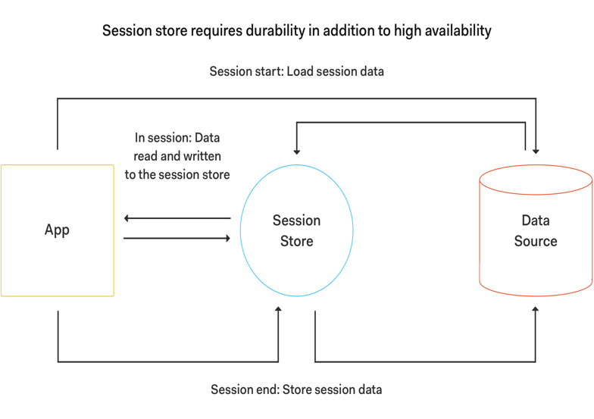
User Session Management
In a session store, the data is not shared between the sessions of different users. The solutions architecture must ensure the data remains isolated between users.
Session store data isn’t ephemeral.
A session store requires replication, high availability, and data durability to ensure transactional data is not lost.
Redis’ Hash data structure is your best choice for session store.
1
2
3
4
5
Notes:
The traditional way to store session information is in the app tier. But this falls short because it requires a session based load-balancer in-front of your web/app-tier in-order to forward the request to the right server. This approach is:
Complex, requires special configuration of the load-balancer.
Not efficient, the load-balancer actually stops balancing the load and only forwards requests to the web/app server that stores the session.
Not reliable as once the web/ app server fails the entire session information is lost.
So if you keep all your session data in a shared and reliable datastore that is accessible from each web/app server and supports high throughput and low-latency operations, your application can perform safely under a high volume of users and operations.

Slide 71
Redis for Real-time Analytics
Redis is exceptionally good for real-time analytic calculations
Top scores
Top ranked contributors
Top posts
Q&A Platforms
To rank the highest voted answers for each proposed question
Gaming App Scoreboards
Leverage Sorted Set to maintain high score lists
Task Scheduling Service
Based on score the task priority changes and high priority task get executed
Geo Hashing
Allows you to index locations based on latitude and longitude
Notes:
Many Q&A platforms like Stack Overflow and Quora use Redis Sorted Sets to rank the highest voted answers for each proposed question to ensure the best quality content is listed at the top of the page.
Online gaming apps leverage Redis Sorted Sets to maintain their high score lists, as scores can be repeated, but the strings which contain the unique user details cannot.
Redis Sorted Sets are a great tool for a task scheduling service, as you can associate a score to rank the priority of a task in your queue. For any task that does not have a score noted, you can use the WEIGHTS option to a default of 1.
The Redis geo indexing API uses a Sorted Set for the Geo Hash technique which allows you to index locations based on latitude and longitude, turning multi dimensional data into linear data.
Your application needs to instantaneously track and show the top bid, the top score or the top opinion. Here’s where Redis SORTED SET plays a simple,

Slide 72
Redis for User Recommendations
It’s quite common for retail or ecommerce sites to recommend items purchased by others who have purchased the same item.
Recommending articles that have the same tags of the article you are reading.
Redis can be used to find common purchases or articles with ease and simplicity.
Analysing Ecommerce Sales
IP Address Tracking.
Inappropriate Content Filtering
Article:3
{tag:1,tag:2,tag:3}
tag:1
{article:3, article:1}
tag:2
{article:22, article:14, article:3}
tag:3
{article:9, article:3, article:2}
Notes:
With most databases, comparing more than 2 tables or collections would create performance issues. With Redis, you can create multiple Sets with the SADD command, then use SINTER to find members of the intersection of all the given sets.
Many online stores use Redis Sets to analyze customer behavior, such as searches or purchases for a specific product category or subcategory. For example, an online bookstore owner can find out how many customers purchased medical books in Psychology.
Redis Sets are a great tool for developers who want to analyze all of the IP addresses that visited a specific website page or blog post, and to be able to ignore all of the duplicates for unique visitors with their SADD function.
For any app that collects user input, it’s a good idea to implement content filtering for inappropriate words, and you can do this with Redis Sets by adding words you’d like to filter to a SET key and the SADD command.

Slide 73
Redis for Managing Queues of Work
Workflow
A workflow, with tasks that need to be processed sequentially, can be managed easily with Redis Lists.
Social Networking Sites.
To populate their homepage feeds and customize trending tweets or stories
RSS Feeds
Create news feeds from custom sources and allow interested followers to subscribe
Leaderboards
Add articles to the leaderboard and sort by most voted entries
Notes:
1. For example, your app could send user bids to an auction system that also needs to send process intensive email notifications; or your app could accept an order for multiple products that also needs to process credit card transactions;
2. Social platforms like Twitter use Redis Lists to populate their timelines or homepage feeds, and can customize the top of their feeds with trending tweets or stories.
3. Create news feeds from custom sources where you can pull the latest updates and allow interested followers to subscribe to your RSS feed.
4. Forums like Reddit and other voting platforms leverage Redis Lists to add articles to the leaderboard and sort by most voted entries.

Slide 74
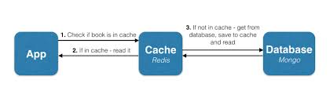
Redis for Caching
An application stores data in the cache to serve future requests faster.
Caching static web pages, HTML fragments, code snippets and media files
Caching User Session information
Object caching for user profiles and hot data
Caching the results of database queries
Notes:
1. For example, your app could send user bids to an auction system that also needs to send process intensive email notifications; or your app could accept an order for multiple products that also needs to process credit card transactions;
2. Social platforms like Twitter use Redis Lists to populate their timelines or homepage feeds, and can customize the top of their feeds with trending tweets or stories.
3. Create news feeds from custom sources where you can pull the latest updates and allow interested followers to subscribe to your RSS feed.
4. Forums like Reddit and other voting platforms leverage Redis Lists to add articles to the leaderboard and sort by most voted entries.

Slide 75

Redis for Caching
CENTRAL CACHE
DATA SOURCE
Application Server
DBMS
Local Redis Cache
Application
Instance

Slide 76
Auto complete

Slide 77
Autocomplete
Data structures needed to implement autocomplete
Sets, Sorted Sets
Performance requirements
Notes:
Explain autocomplete and how it is a standard in the industry
Functional Requirements for autocomplete
Non Functional Requirements for autocomplete – performance, on failure

Slide 78
Autocomplete
Autocomplete - Demo

Slide 79
Pub Sub, Chat and Events

Slide 80
Pub Sub
Notify
Notes:
- Consider the use case of twitter and tweets.
- Prime minister has more then 50 million followers
- When he tweets something, all his followers need to be notified of the tweet and it should show up in their twitter feed.
- Similar kind of examples exists in other social networking sites such as facebook, instagram etc.
- Not only social networking sites, any modern application (mobile/web) require this kind of real time communication

Slide 81
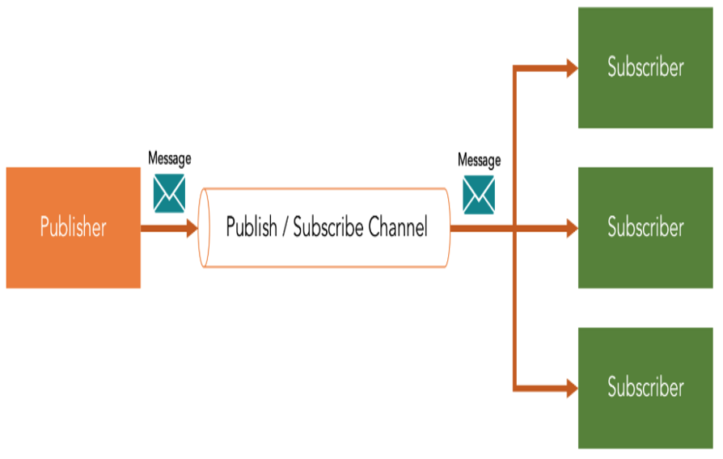
Publish/Subscribe Pattern
Publisher: Publishes messages to the communication infrastructure
Subscriber: Subscribes to a category of messages
Communication infrastructure (channel): Receives messages from publishers and maintains subscribers’ subscriptions.

Slide 82
PubSub Patterns
Publisher
Channel
Subscriber
1 to 1
Subscriber
Publisher
Channel
Subscriber
Subscriber
1 to N
Publisher
Publisher
Channel
Subscriber
N to 1
Publisher
PUBLISH pm_channel "Welcome to PM Channel”
SUBSCRIBE pm_channel
Notes:
One to one pattern
One to many pattern/fan out pattern
Many to one pattern/fan in pattern

Slide 83
Chat Room Usecase
User-1
User-2
Room
User-3
Room
=
Channel
Notes:
Execute iterm2 terminal windows with four windows
Execute redis-cli on all four windows
Execute “subscribe ch1” on windows 2 & 3
Execute “subscribe ch2” on windows 1
-----
How to find number of chat rooms?
In the first window, PUBSUB CHANNELS *
How to find subscribers for each chat room?
PUBSUB NUMSUB ch1
PUBSUB NUMSUB ch2

Slide 84
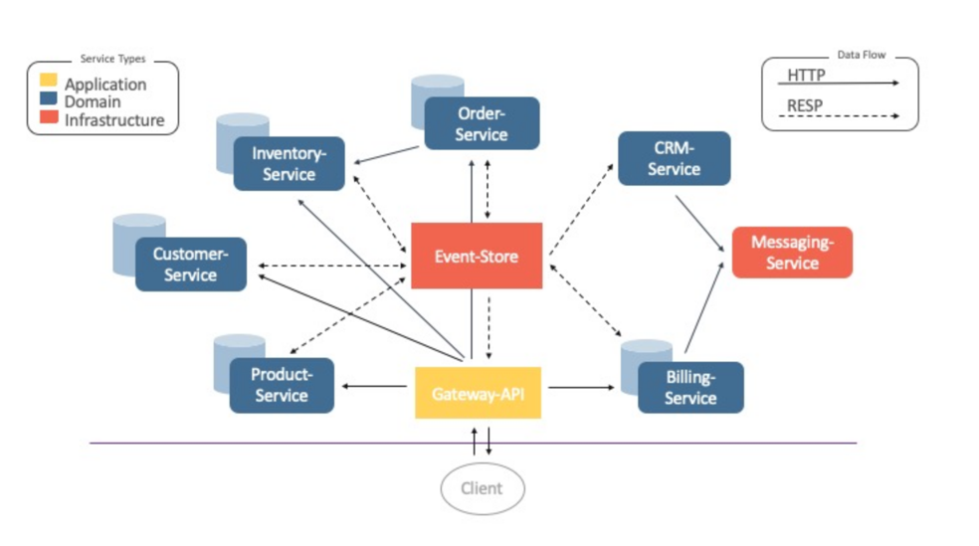
Event Driven Architectures
Order Shop
Architecture with
Event Store
Notes:
Talk about uber/ola design and how event driven architecture is utilized

Slide 85
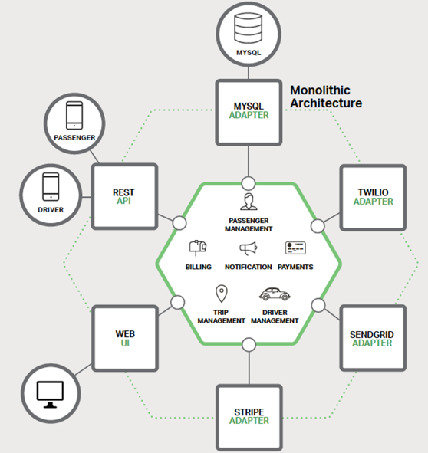
Event Driven Architectures
Sample
Taxi Handling
Application
Notes:
Talk about uber/ola design and how event driven architecture is utilized

Slide 86
Event Driven Architectures
Demo
Notes:
Execute iterm2 terminal windows with three windows
Execute redis-cli on all three windows
Execute “subscribe ch1” on windows 2 & 3
Execute “publish ch1 ”Hi There!” “ on window 1. Message should show up in windows 2 & 3
-----
On Window 3, execute psubscribe ch*. Psubscribe is pattern subscribe where channel matching is based on patterns
Now, type “publish ch12 “Hi There!” ” on window 1. Message should appear in window 3, but not in window 1
-----
Terminate redis-cli on window 2
Execute “publish ch1 ”Hi There!” “ on window 1, message will show up in window 3.
On Window 1, execute “subscribe ch1”. But the message executed before the subscribe does not show up. No way to go back with messaging.

Slide 87
Geo Search

Slide 88
Geo Spatial Data
Fetching the location (“Where are they?”)
Location updates (“I am here”)
Searching data by location (“Who is near this location?”)

Slide 89
Geo Search
Landmark: Location to search from
Hotel Locations
Distance in km

Slide 90
Geospatial Index
Data structure that is specialized for managing geospatial indices.
Each Geo Set is made up of one or more members, with each member consisting of a unique identifier and a longitude/latitude pair.
Like all Redis’ data structures, Geo Sets are manipulated and queried using a subset of simple-to-use and at the same time highly-optimal commands.
Internally, Geo Sets are implemented with another Redis data structure called a Sorted Set.
Sorted Sets exhibit a good spacetime balance by consuming a linear amount of RAM while providing logarithmic computing complexity for most operations.

Slide 91
Dealing with Geospatial data
Add Location:
GEOADD locations 10.9971645 45.4435245 Romeo
Add Multiple Locations:
GEOADD locations 10.9971645 45.4435245 Mercutio 10.9962165 45.4419226 Juliet
Update:
GEOADD locations 10.999216 45.4432923 Romeo
Remove Location:
ZREM locations Mercutio

Slide 92
Reading Geospatial data
GEOPOS locations Romeo
1) 1) 10.999164
2) 45.442681
GEORADIUSBYMEMBER locations Romeo 100 m
1) “Juliet”

Slide 93
Technical Details: GeoHash
Geohash is a latitude/longitude geocode system invented by Gustavo Niemeyer when writing the web service at
geohash.org, and put into the public domain.
Redis uses this system for mapping between pairs of valid4 coordinates and their hash values.
While the original Geohash system uses base-32 representation of the hash value (for humane reasons), Redis simply stores the hash’s numerical representation as the member’s score in the Geo Set.

Slide 94
Technical Details: GeoHash
Geohashes are more than just a clever encoding method - their structure makes it possible to search efficiently. As shown
above, the hash’s length determines its accuracy. Put differently, the shorter that the hash is, the bigger the area that it covers.
That means that searching for locations within a given cell is simply a matter of retrieving all the locations that share that cell’s prefix. Consider, for example Juliet’s binary Geohash value:
1101000000111010101101100000011111100001111000001111
The italicized part is that hash’s longest possible prefix. Permuting the last two (least significant) bits provides that cell’s 3
immediate neighbours, namely:
1101000000111010101101100000011111100001111000001100
1101000000111010101101100000011111100001111000001101
1101000000111010101101100000011111100001111000001110
Searching for all locations that have that prefix is therefore a range search for all scores between 1101..1100 and 1101..1111.
By using a shorter Geohash search prefix the search is done in a bigger cell.
The basic search described above is used in implementing the more robust points-in-radius search. Given the circle’s center and radius, Redis performs a Geohash search of the cell containing the center and the 8 cells that surround it (total of 9 cells).
The distance from the center to each member found is checked, and if it is less or equal to the radius then it is included in the reply.

